Slide 1




Mastering Hadoop File System Operations
The Hadoop Distributed File System (HDFS) is a cornerstone technology for storing and handling big data. For IT professionals and students alike, understanding how to interact with HDFS is essential for managing large-scale data in a Hadoop environment. Following a series of command-line instructions, one can navigate HDFS with confidence, executing tasks from basic file creation to complex data management. This exploration covers practical commands and expands upon the intricacies of Hadoop operations to empower you with a deeper grasp of this powerful ecosystem.
by Prasanthi Battina

Slide 2
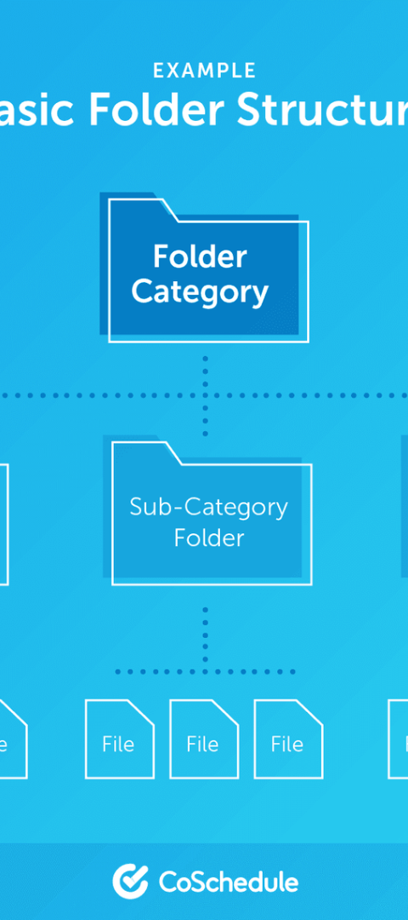
Creating Directories in HDFS
Command Structure
The -p Flag
Understanding the Hadoop command structure is vital. The 'mkdir' command is uncomplicated yet powerful, allowing for the creation of nested directory hierarchies with simplicity and precision.
The use of the '-p' flag signifies the creation of parent directories as needed, ensuring that the complete path exists upon completion of the command, a fundamental aspect for maintaining structured data storage.
Directory Hierarchy
Creating a well-organized directory structure promotes efficient data retrieval and management—a crucial practice when handling large volumes of data within HDFS.

Slide 3




Moving Files to HDFS
Select Source
Initiate the file transfer by accurately specifying the local source path, ensuring the file exists and is accessible for upload to HDFS.
Specify Destination
Delineate the target directory path in HDFS to place the file, a critical step for maintaining data organization within the distributed file system.
Transfer Initiation
Executing the 'put' command commences the data transfer, flawlessly moving the file from the local system to the designated HDFS directory.

Slide 4

Viewing File Contents in HDFS
1
Command Invocation
To peek into the content of a file, utilize the 'cat' command, which streams the file directly onto your screen for immediate read access.
2
File Path Specification
Correct file path specification ensures that the data you intend to view is retrieved without error from the HDFS repository.
3
Data Inspection
Upon command execution, the contents unfurl in the command-line interface, allowing for rapid inspection or analysis of your HDFS-stored data.

Slide 5
List Contents of HDFS Directories
The ls Command
Path Authentication
Interpreting Output
The 'ls' command in HDFS mirrors its Unix equivalent, providing a snapshot of files and subdirectories within the specified directory.
Ensuring the accuracy of the directory path is paramount to receiving the desired directory contents listing from HDFS.
An understanding of the output format, including permission bits and file sizes, is essential for an effective interactive HDFS experience.

Slide 6

Retrieving HDFS Files to the Local System
Command Selection
1
Selecting the 'get' command initiates the process of copying files from the Hadoop environment to a local directory, bridging the gap between distributed and local file systems.
2
HDFS Source Path
Accurate designation of the HDFS file path facilitates a smooth data transfer, retrieving the information from its Hadoop repository.
Local Destination
3
Sending the file to a premeditated local directory ensures its availability for processing, analysis, or backup on the local machine.

Slide 7
Hadoop File System Command Summary
Command
Action
Flag
Path
mkdir
Create directory
-p
HDFS directory path
put
Upload file
N/A
Local & HDFS paths
cat
View file content
N/A
HDFS file path
ls
List directory content
N/A
HDFS directory path
get
Download file
N/A
HDFS & Local paths

Slide 8
Optimizing HDFS Operations
1
Path Consistency
2
Command Knowledge
3
Resource Monitoring
Maintaining consistency in file and directory paths prevents errors during command execution and is crucial for seamless operations within HDFS.
Proficiency with command functionalities allows for optimization of data management tasks within the Hadoop ecosystem.
Monitoring the effective usage of HDFS resources, such as space utilization, ensures the longevity and scalability of the Hadoop cluster.

